Slide 1
PYTHON OOP

Slide 2
Agenda
Classes and Objects
Encapsulation
Inheritance
Polymorphism

Slide 3
Classes and Objects

Slide 4
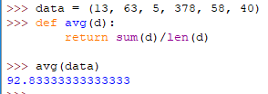
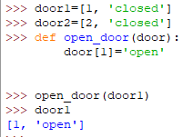


1. Plain old procedures
2. Procedures can modify data
3. Things can get complicated

Slide 5




The meaning of the word 'class'
The meaning of the word 'instance'

Slide 6


The meaning of the word 'type'
Behavioural meaning
Structural meaning
The behavioural meaning is important

Slide 7
Everything in Python is an object
Python is an object oriented programming language.
Object is simply a collection of data (variables) and methods (functions) that act on those data
Class is a blueprint for the object. We can create many objects from a class
Instantiation - the process of creating object. And this object is also called an instance of a class.
Notes:
Якщо ми розробимо проект будинку, ми розробимо – клас. З цього проекту, ми зможемо побудувати багато будинків – об’єктів.

Slide 8
Class Definition
To determine the class, you use class operator:
In a class can be basic (parent) classes (superclasses), which (if any) are listed in parentheses after the defined class.
The smallest possible class definition looks like this:
class ClassName (superclass 1, superclass 2, ...):
# Define attributes and methods of the class
class A:
pass
Notes:
A class creates a new local namespace where all its attributes are defined. Attributes may be data or functions.

Slide 9
Class methods & attributses
In the terminology of the Python members of the class are called attributes, functions of the class - methods and fields of the class - properties (or simply attributes).
Definitions of methods are similar to the definitions of functions, but (with some exceptions, of which below) methods always have the first argument, called on the widely accepted agreement self:
Definitions of properties - the usual assignment operators that connect some of the values with attribute names:
class A:
def m1 (self, x):
# method code block
class A:
attr1 = 2 * 2
Notes:
A class creates a new local namespace where all its attributes are defined. Attributes may be data or functions.
There are also special attributes in it that begins with double underscores (__). For example, __doc__ gives us the docstring of that class.
As soon as we define a class, a new class object is created with the same name. This class object allows us to access the different attributes as well as to instantiate new objects of that class.

Slide 10
Class Definition
In Python a class is not something static after the definition, so you can add attributes and after:
class A: pass
def myMethod (self, x): return x * x
A.m1 = myMethod
A.attr1 = 2 * 2

Slide 11
Methods
Syntax of a method has no difference from the description of a function, except for its position within a class and specific first formal parameter self, using which the inside of the method can be invoked the class instance itself (the name of self is a convention that Python developers follow to):
class MyClass(object):
def mymethod(self, x):
return x == self._x
Notes:
You may have noticed the self parameter in function definition inside the class but, we called the method simply as ob.func() without any arguments. It still worked.
This is because, whenever an object calls its method, the object itself is passed as the first argument. So, ob.func() translates into MyClass.func(ob).

Slide 12
Class Instantiation
To instantiate a class, that is, create an instance of the class, simply call the class name and specify the constructor parameters:
__init__ is the default constructor. We normally use it to initialize all the variables.
self refers to the object itself.
class Point:
def __init__ (self, x, y, z):
self.coord = (x, y, z)
def __repr__ (self):
return "Point (%s, %s, %s)" % self.coord
>>> P = Point(0.0, 1.0, 0.0)
>>> P
Point (0.0, 1.0, 0.0)
Notes:
Class functions that begins with double underscore (__) are called special functions as they have special meaning.
__repr__ goal is to be unambiguous
__str__ goal is to be readable

Slide 13
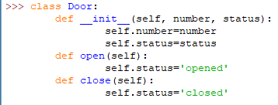
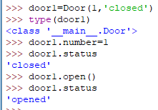
The first class
Keep data and functions together

Slide 14
Constructor and Destructor
Special methods are invoked at instantiation of the class (constructor) and disposal of the class (destructor). In Python is implemented automatic memory management, so the destructor is required very often, for resources, that require an explicit release.
The next class has a constructor and destructor:
class Line:
def __init__(self, p1, p2):
self.line = (p1, p2)
def __del__(self):
print ("Removing Line %s - %s" % self.line)
>>> L = Line((0.0, 1.0), (0.0, 2.0))
>>> del L
Removing Line (0.0, 1.0) - (0.0, 2.0)

Slide 15



Where is the class of an object?

Slide 16
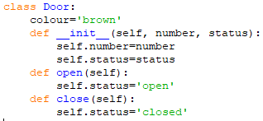
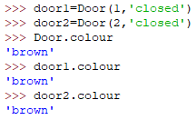
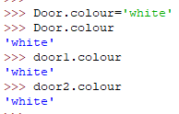

Class attributes

Slide 17
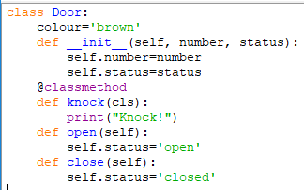

Class methods
From functions to bound methods

Slide 18
Encapsulation
Notes:
The concept of Encapsulation is to keep together the implementation (code) and the data it manipulates (variables). Having proper encapsulation ensures that the code and data both are safe from misuse by outside entity.

Slide 19
Encapsulation
When a Python class is created it contains the methods and the variables. Since it’s the code in the methods that operates on the variables, in a properly encapsulated Python class, methods should define how member variables can be used.
In Python there are no explicit access modifiers and everything written with in the class (methods and variables) are public by default.

Slide 20
Encapsulation and access to properties
Encapsulation is one of the key concepts of OOP. All values in Python are objects that encapsulate code (methods) & data and provide users a public interface. Methods and data of an object are accessed through its attributes.
Hiding information about the internal structure of the object is performed in Python at the level of agreement among programmers about which attributes belong to the public class interface, and which - to its internal implementation.
Notes:
A single underscore in the beginning of the attribute name indicates that the method is not intended for use outside of class methods (or out of functions and classes of the module), but the attribute is still available by this name.
Two underscores in the beginning of the name give somewhat greater protection: the attribute is no longer available by this name. The latter is used quite rarely.

Slide 21
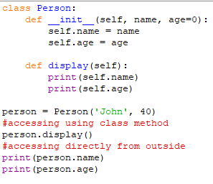

Encapsulation
For example in the class Person there are two variables as you can see those variables are accessed through a method as well as directly.

Slide 22
Public, private and protected data
If an identifier doesn't start with an underscore character it is public members and it can be accessed from outside, i.e. the value can be read and changed.
Instance variable names starting with two underscore “__” characters is private and cannot be accessed from outside of the class. At least not directly, but they can be accessed through private name mangling. That means, private data __A can be accessed by the following name construct: instance_name._classname__A.
If an identifier is only preceded by one underscore character “_”, it is a protected member. Protected members can be accessed like public members from outside of class.

Slide 23
Encapsulation and access to properties
Access to the attribute can be either direct:
…Or using the properties with the specified methods for getting, setting and removing an attribute
>>> class A(object):
... def __init__(self, x):
... # attribute gets the value in the constructor
... self.x = x
...
>>> a = A(5)
>>> print (a.x)
5

Slide 24
Using single underscore
Using a single leading underscore is merely a convention. A name prefixed with an underscore in Python (as example _name) should be treated as a non-public part of the API (whether it is a function, a method or a data member).
As mentioned it is just a convention and a leading underscore doesn’t actually make any variable or method private or protected. It’s just that if you see a variable or method with a leading underscore in Python code you should follow the convention that it should be used internally with in a class.

Slide 25
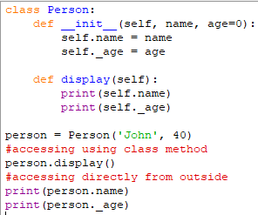

Using single underscore
For example in class Person if age variable is changed and it is prefixed with underscore.
Notes:
As you can see these variables can still be accessed from outside the class.

Slide 26
Using double underscore
If you really want to make a class member (member or variable) private in Python you can do it by prefixing a variable or method with double underscores. Here note that Python provides a limited support for private modifier using a mechanism called name mangling and it is still possible to access such class member from outside the class.
In Python any identifier of the form __var (at least two leading underscores, at most one trailing underscore) is rewritten by the Python interpreter in the form _classname__var, where classname is the current class name. This mechanism of name changing is known as name mangling in Python.

Slide 27
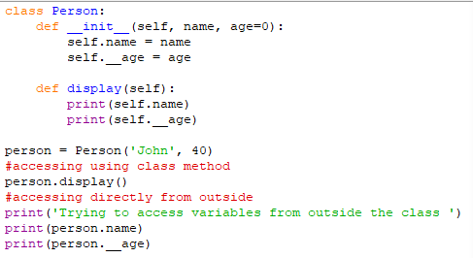
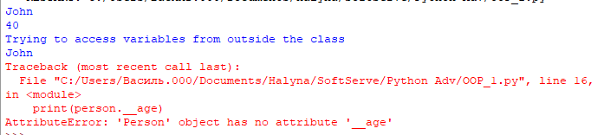
Using double underscore
For example in class Person age variable is changed and it is prefixed with two leading underscores.
Notes:
As you can see variables can still be accessed using the method which is part of the class but age (which is a private variable) can’t be accessed directly from outside now.

Slide 28
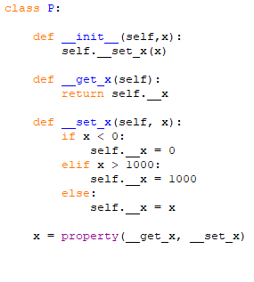
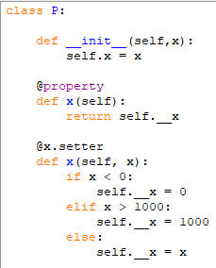
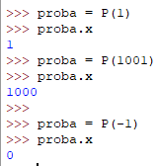
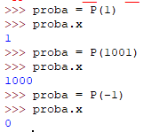
Encapsulation: property
We can use properties with the specified methods for getting, setting and removing an attribute
attribute = property(get, set, del, doc)
Alternatively, we could have used a different syntax with @property, @my_attr.setter, …
decorators to define the property.
Notes:
@property it is @my_attr.getter by default
NOTE, the decorator form of @property and @my_attr.setter is more pythonic
>>> from p import P
>>> p1 = P(1001)
>>> p1.x
1000
>>> p1.x = -12
>>> p1.x
0
>>>
https://www.python-course.eu/python3_properties.php
________________________________________________
class Account(object):
@property
def email(self):
return self._email
@email.setter
def email(self, value):
if '@' not in value:
raise ValueError('Invalid email address.')
self._email = value
then the user of the class does not expect that assigning a value to the property could cause an exception:
a = Account()
a.email = 'badaddress'
ValueError: Invalid email address.
_____________________

Slide 29
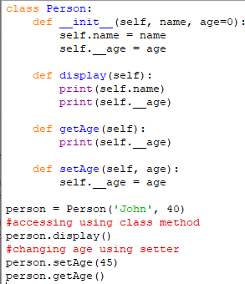

Using getter and setter methods
To access and change private variables accessor (getter) methods and mutator (setter methods) should be used which are part of the class.

Slide 30
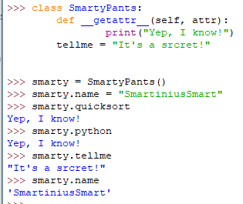
Encapsulation: __getattribute__()
There are two ways to centrally control access to attributes.
The first is based on method overloading
__getattr__(),
__setattr__(),
__delattr__().
The second - the method __getattribute__().
This method helps to manage reading of the existing attributes. These methods allow you to organize a fully dynamic access to the attributes of the object or that is used very often, and imitation of non-existent attributes.
__getattribute__ is the mechanism by which property (and other descriptor objects) do their work.

Slide 31
Inheritance

Slide 32



Specialization
Animal
Cat
Cat has all the features of Animal,
i.e. 'moves'
Animal
Cat
Animal
Cat
Cat may provide new features, i.e. 'has whiskers'

Slide 33




Specialization
Cat implements only 'new' or 'changed' features
Cat performs some or all the tasks performed by Animal in a different way, i.e. 'moves silently'
Animal
Cat
Animal
Cat
Cat delegates the remaining features to Animal

Slide 34

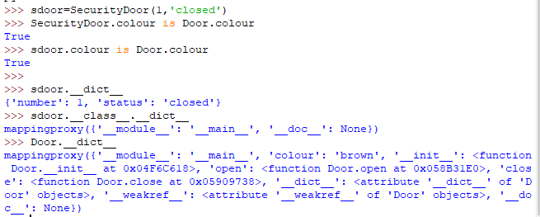
Inheritance
Door.colour
SecurityDoor.colour
sdoor.colour

Slide 35
Inheritance and Multiple Inheritance
Python supports both single inheritance and multiple, allowing the class to be derived from any number of base classes.
Derived class inherits features from the base class, adding new features to it. This results into re-usability of code.
class Par1 (object):
def method_1(self):
return '(Par1 method_3)'
def method_2(self):
return '(Par1 method_2)'
class Par2 (object):
def method_2(self):
return '(Par2 method_2)'
def method_3(self):
return '(Par2 method_3)'
class Child (Par1, Par2):
pass
x = Child()
print (x.method_1(), x.method_2(), x.method_3())
(Par1 method_3) (Par1 method_2) (Par2 method_3)
class Child (Par2, Par1):
pass
x = Child()
print (x.method_1(), x.method_2(), x.method_3())
(Par1 method_3) (Par2 method_2) (Par2 method_3)
Notes:
class Polygon:
def __init__(self, no_of_sides):
self.n = no_of_sides
self.sides = [0 for i in range(no_of_sides)]
def inputSides(self):
self.sides = [float(input("Enter side "+str(i+1)+" : ")) for i in range(self.n)]
def dispSides(self):
for i in range(self.n):
print("Side",i+1,"is",self.sides[i])

Slide 36
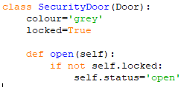
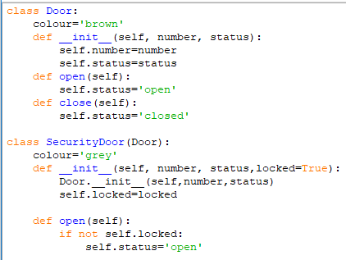
Overriding

Slide 37
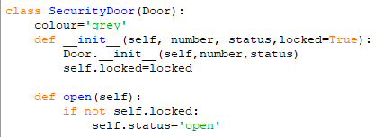

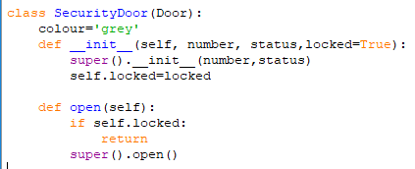
Overriding
Avoid strong coupling

Slide 38
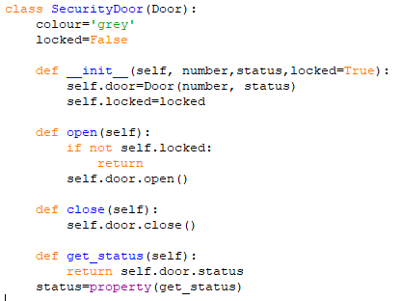
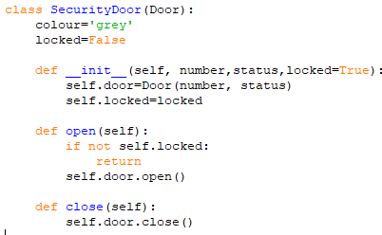

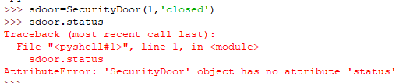
Composition

Slide 39
Polymorphism

Slide 40
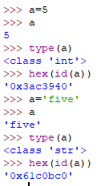


References
Strong type system: every variable has a type
Dynamic type system: the type changes with the content

Slide 41
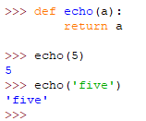
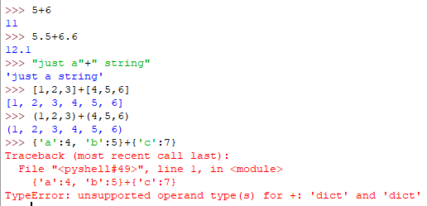
Every variable is a reference
What is polymorphism?

Slide 42
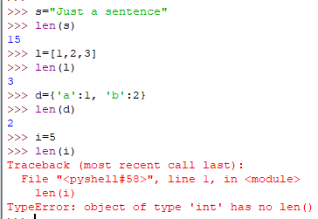
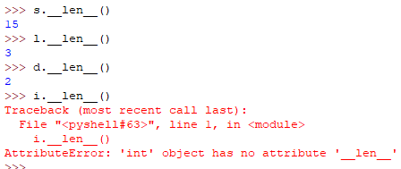
What is polymorphism?

Slide 43
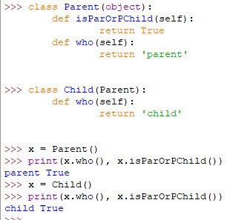
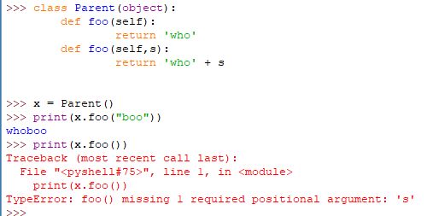
Polymorphism
Poly = many: Morph = change or form
So polymorphism is the ability (in programming) to present the same interface for differing underlying forms (data types).
Notes:
The classic example is the Shape class and all the classes that can inherit from it (square, circle, dodecahedron, irregular polygon, splat and so on).
Sometimes an object comes in many types or forms. If we have a button, there are many different draw outputs (round button, check button, square button, button with image) but they do share the same logic: onClick(). We access them using the same method . This idea is called Polymorphism.
class Animal:
def __init__(self, name): # Constructor of the class
self.name = name
def talk(self): # Abstract method, defined by convention only
raise NotImplementedError("Subclass must implement abstract method")
class Cat(Animal):
def talk(self):
return 'Meow!'
class Dog(Animal):
def talk(self):
return 'Woof! Woof!'
animals = [Cat('Missy'),
Cat('Mr. Mistoffelees'),
Dog('Lassie')]
for animal in animals:
print animal.name + ': ' + animal.talk()
# prints the following:
#
# Missy: Meow!
# Mr. Mistoffelees: Meow!
# Lassie: Woof! Woof!

Slide 44
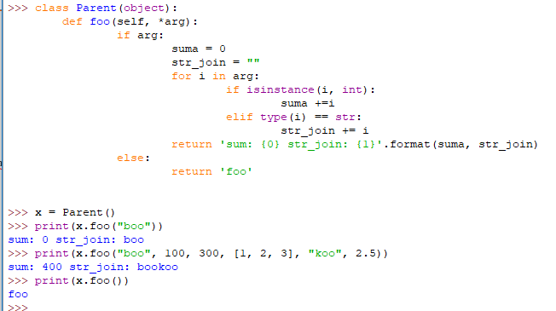
Polymorphism

Slide 45
Polymorphism
Explicitly specifying the name of the class, you can call the method of the parent (as well as any other object):
In general case to get the parent class the function super is applied:
>>> class Child (Parent):
... def __init__ (self):
... Parent.__init__(self)
...
>>> class Child(Parent):
... def __init__ (self):
... super(Child, self).__init__(self)
...

Slide 46
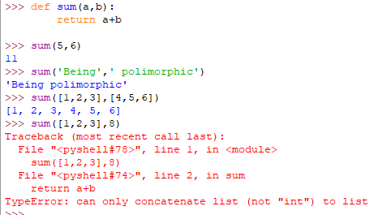
Polymorphism is based on delegation

Slide 47
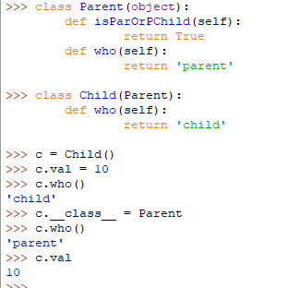
Polymorphism
Changing attribute __class__, you can move an object up or down the inheritance hierarchy (as well as to any other type):
However, in this case, no type conversions are made, so care about data consistency remains entirely on the programmer.

Slide 48
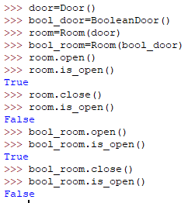
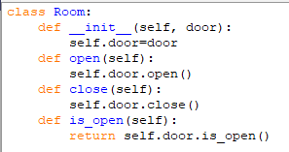
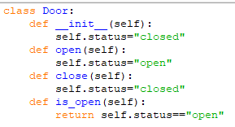
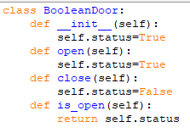
Polymorphism in action

Slide 49
Thank you!

